Slide 1
Business Center
Notes:
Released Feb 2013. Started June 2012. several interviews with Bus Reps (14) conducted as well as with businesses. Put everything in one place. Resources for employers with no HR dept. Tax incentives, social media, economic development, legal issues, most current information available, page specific resources boxes

Slide 2
Business Center

Slide 3
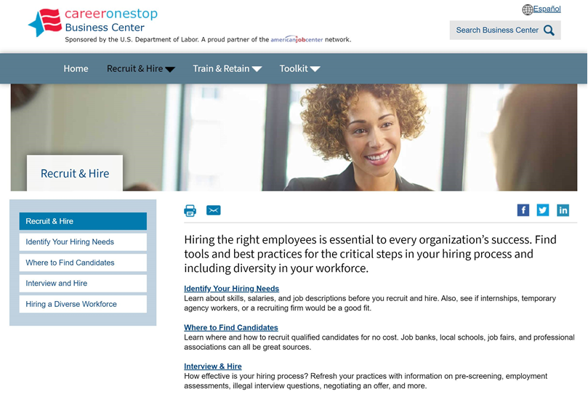
Recruit and Hire
Identify your hiring needs
Where to Find Candidates
Interview & Hire
Hiring a Diverse Workforce
Notes:
Veterans section under hiring a diverse workforce (disabilities, youth, etc)
Civilian to Military translator- Find codes to look for when hiring vets
Interview and Hire- employment law- business reps find it helpful
Find qualified candidates- state job banks and more

Slide 4
Train and Retain
Employee Skills Needs
Training Options
Funding Employee Training
Manage and Retain Employees
Notes:
Training finder top tool- provides list of training institutions to train employees or to recruit graduates with your needed skill sets
Certification finder- find certifications to provide to your employees or what to look for when recruiting new hires

Slide 5
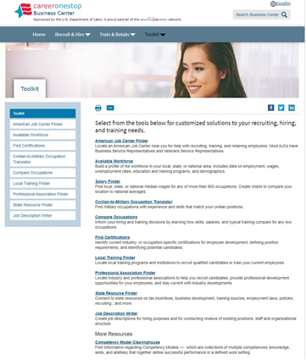
Business Center Toolkit
Tools include:
American Job Center Finder
Available Workforce
Civilian-to-Military Occupation
Compare Occupations
Find Certifications
Find Local Training
Find Professional Associations
Find State Resources
Job Description Writer

Slide 6
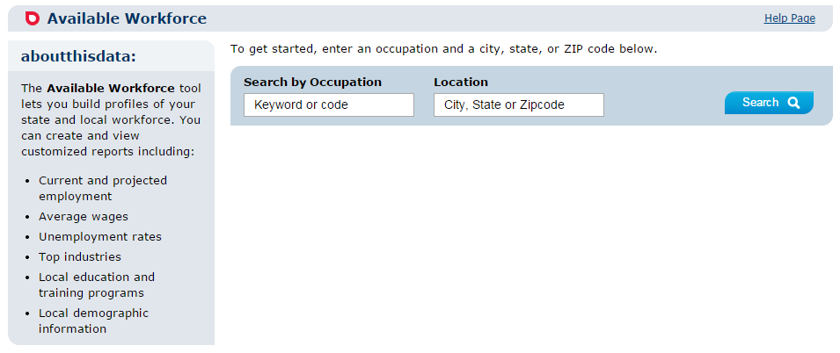
Available Workforce Tool
Notes:
Hiring needs assessment, supply of employees, occupation reports, what to pay employees.
*occupation specific
*location specific

Slide 7
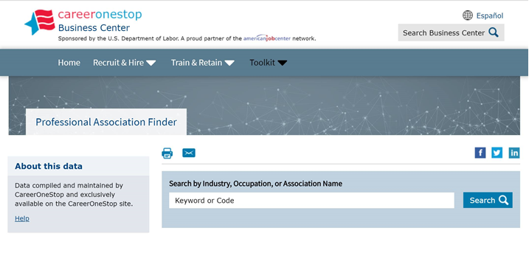
Find Professional Associations Tool
Notes:
Find associations for industry or occupation. Can help employers to recruit candidates, find out trends or find programs for employees to participate in for professional development

Slide 8
Job Description Writer
Notes:
Job description writer improved. Basically writes job description for you and can be edited. Can create pdf, word document to be exported to a job bank

Slide 9
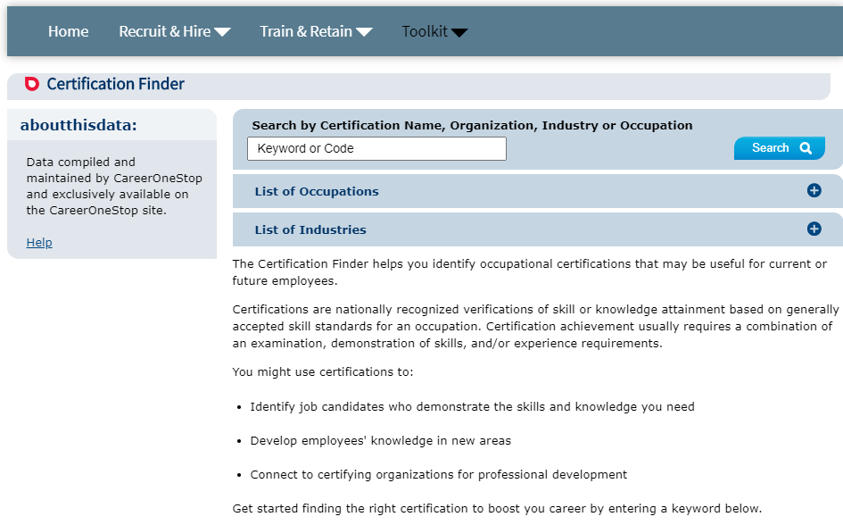
Certification Finder
Notes:
Find certifications

Slide 10
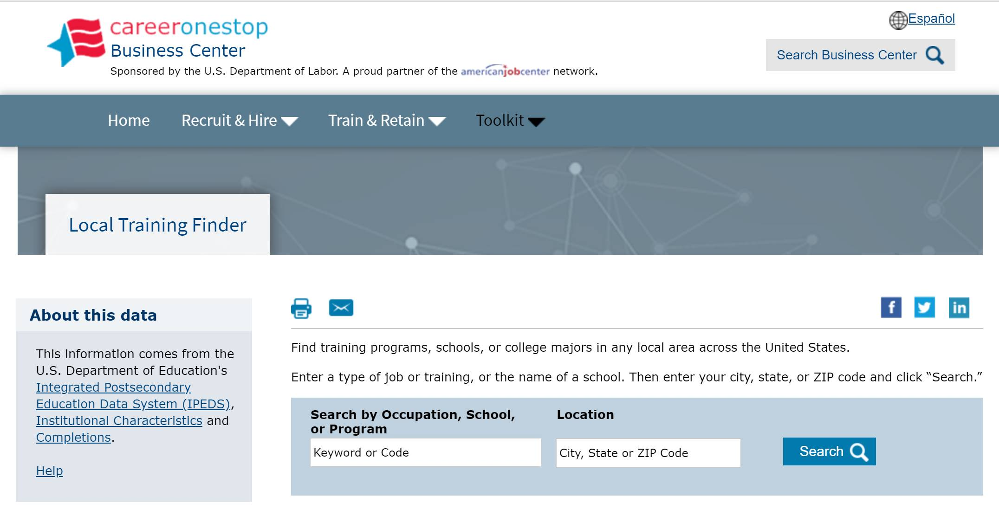
Find Local Training Programs Tool
Notes:
Mentioned earlier, find training programs from which you can recruit or send employees for additional training. Customized training may also be another option for employers on a case by case basis

Slide 11
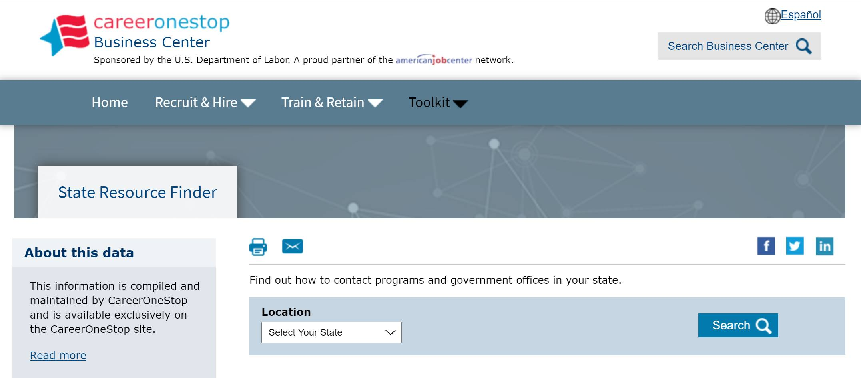
Find State Resources
Notes:
Business reps wanted everything in one place

Slide 12
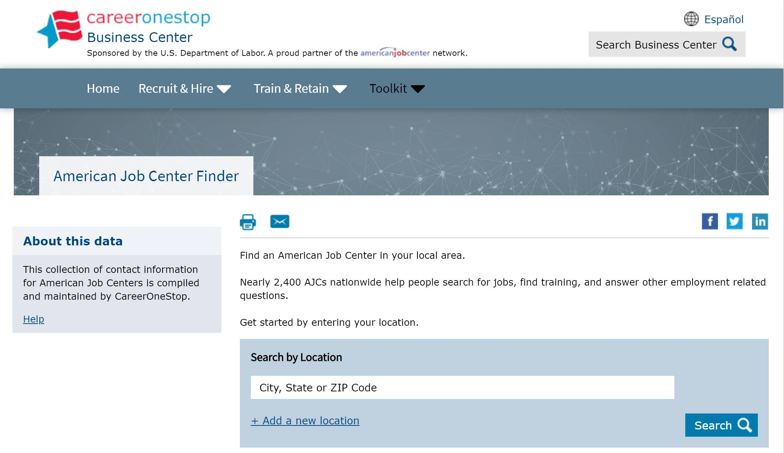
American Job Center Finder
Notes:
Find offices, business reps, vet reps, state services, etc… Results pages provide very specific results (business rep names and numbers) in regards to services available in local offices.
*email your business rep

Slide 13
Resources
U.S. Department of Labor Employment & Training Administration: www.doleta.gov
CareerOneStop: www.careeronestop.org
GetMyFuture: www.GetMyFuture.org
Credentials Center: www.careeronestop.org/Credentials
Business Center: www.careeronestop.org/BusinessCenter
Veteran and Military Transition Center: www.careeronestop.org/Veterans
Worker ReEmployment: www.careeronestop.org/ReEmployment
Competency Model: www.careeronestop.org/CompetencyModel
mySkills myFuture: www.mySkillsmyFuture.org
Notes:
Print these page for easy access to our web sites!

Slide 14
CareerOneStop on Social Media
Twitter: https://twitter.com/Career1Stop
LinkedIn: https://www.linkedin.com/company/careeronestop
Facebook: https://www.facebook.com/pages/Careeronestop/135511219941994
Instagram: https://www.instagram.com/careeronestop/
Pinterest: https://www.pinterest.com/CareerOneStop/
YouTube: https://www.youtube.com/user/CareerOneStop

Slide 15
Contact Us
Contact CareerOneStop
E-mail: info@CareerOneStop.org
US2-JOBS Toll-Free Help Line
1-877-US2-JOBS (TTY: 1-877-889-5627)

